Slide 1
GPU Computing

Slide 2
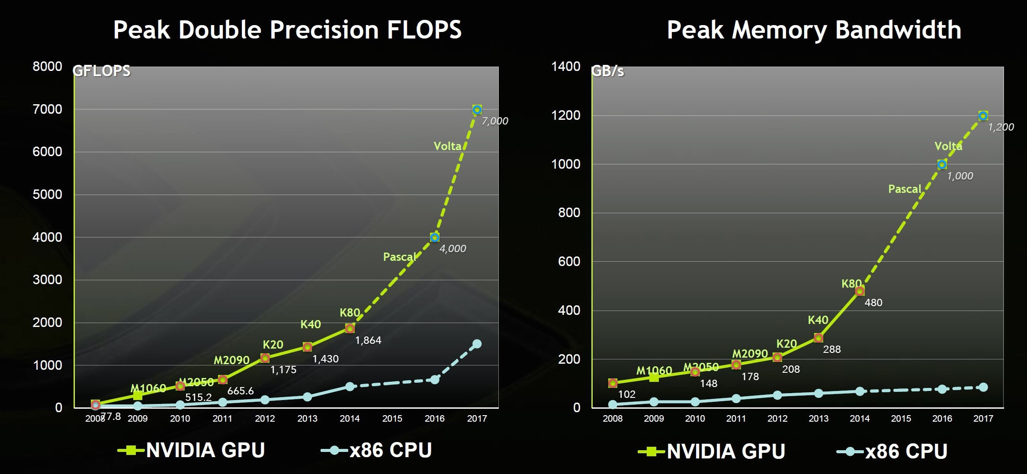
GPU vs. CPU Performance
Energy difference: 200pJ/instruction (GPU) vs. 2000pJ/instruction (CPU)
Source: NVIDIA

Slide 3
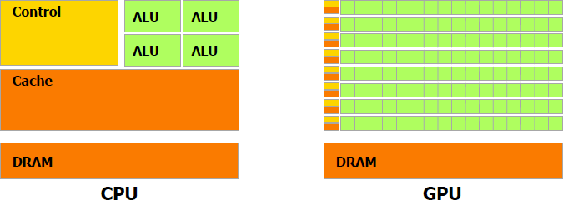
CPU vs. GPU
(Source: Nvidia CUDA Programming Guide)
GPU’s higher performance and energy efficiency are due to different allocation of chip area
High degree of SIMD parallelism, simple in-order cores, less control/sync. logic, lower cache/scratchpad capacity
But SIMD parallelism is not well suited for all algorithms
Dynamic search, Sparse computations, Quad-tree/Oct-tree data structures, Graph algorithms, etc.
Future systems will be heterogeneous

Slide 4
NVIDIA GPU Architecture
Device
Stream Processor N
Stream Processor 1
Stream Processor 0 (SM)
Instruction Cache
Shared Memory
Host
Warp 0
Warp 1
Warp N
CPU
Shared Registers File
Shared Registers File
Shared Registers File
Core 0
Core 30
Core 32
Core 62
Core …
Core …
Core 1
· · ·
Core 31
Core 33
· · ·
Core 63
· · ·
Core …
· · ·
Core …
Warp Scheduler
Warp Scheduler
Warp Scheduler
Instruction Buffer
Instruction Buffer
Instruction Buffer
PCI-E
Constant Memory
Texture Memory/L1 Cache
Host memory
L2 Cache
Global Memory

Slide 5
Software Abstraction
Grid 0
Device 0
Stream Processor N
Block 0
Block 1
Shared Memory
Shared Memory
Stream Processor 1
Stream Processor 0 (SM)
Registers
Registers
Registers
Registers
Instruction Cache
Shared Memory
Thread(tid) 0
Thread 1
Thread 0
Thread 1
Warp 0
Warp 1
Warp N
Shared Registers File
Shared Registers File
Shared Registers File
Core 0
Core 30
Core 32
Core 62
Core …
Core …
Core 1
· · ·
Core 31
Core 33
· · ·
Core 63
· · ·
Core …
· · ·
Core …
Warp Scheduler
Warp Scheduler
Warp Scheduler
Instruction Buffer
Instruction Buffer
Instruction Buffer
Global Memory
Constant Memory
Texture Memory/L1 Cache
L2 Cache
Global Memory

Slide 6


Slide 7
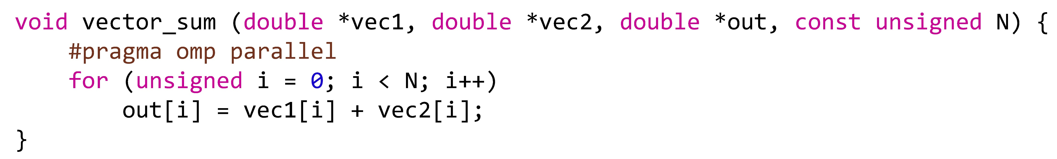
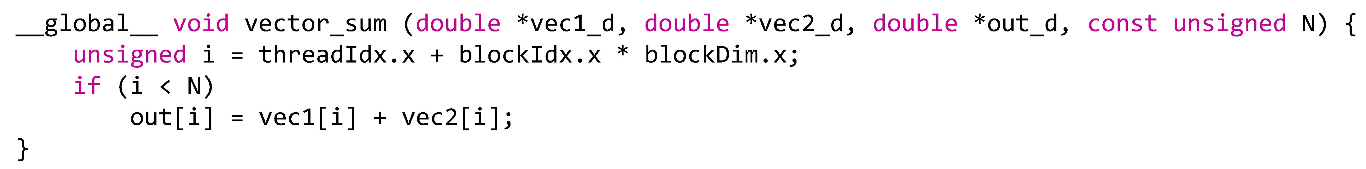

Slide 8
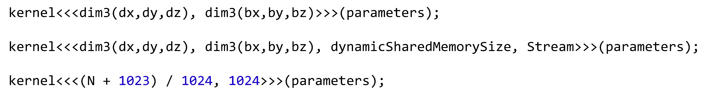
Kernel Launch

Slide 9
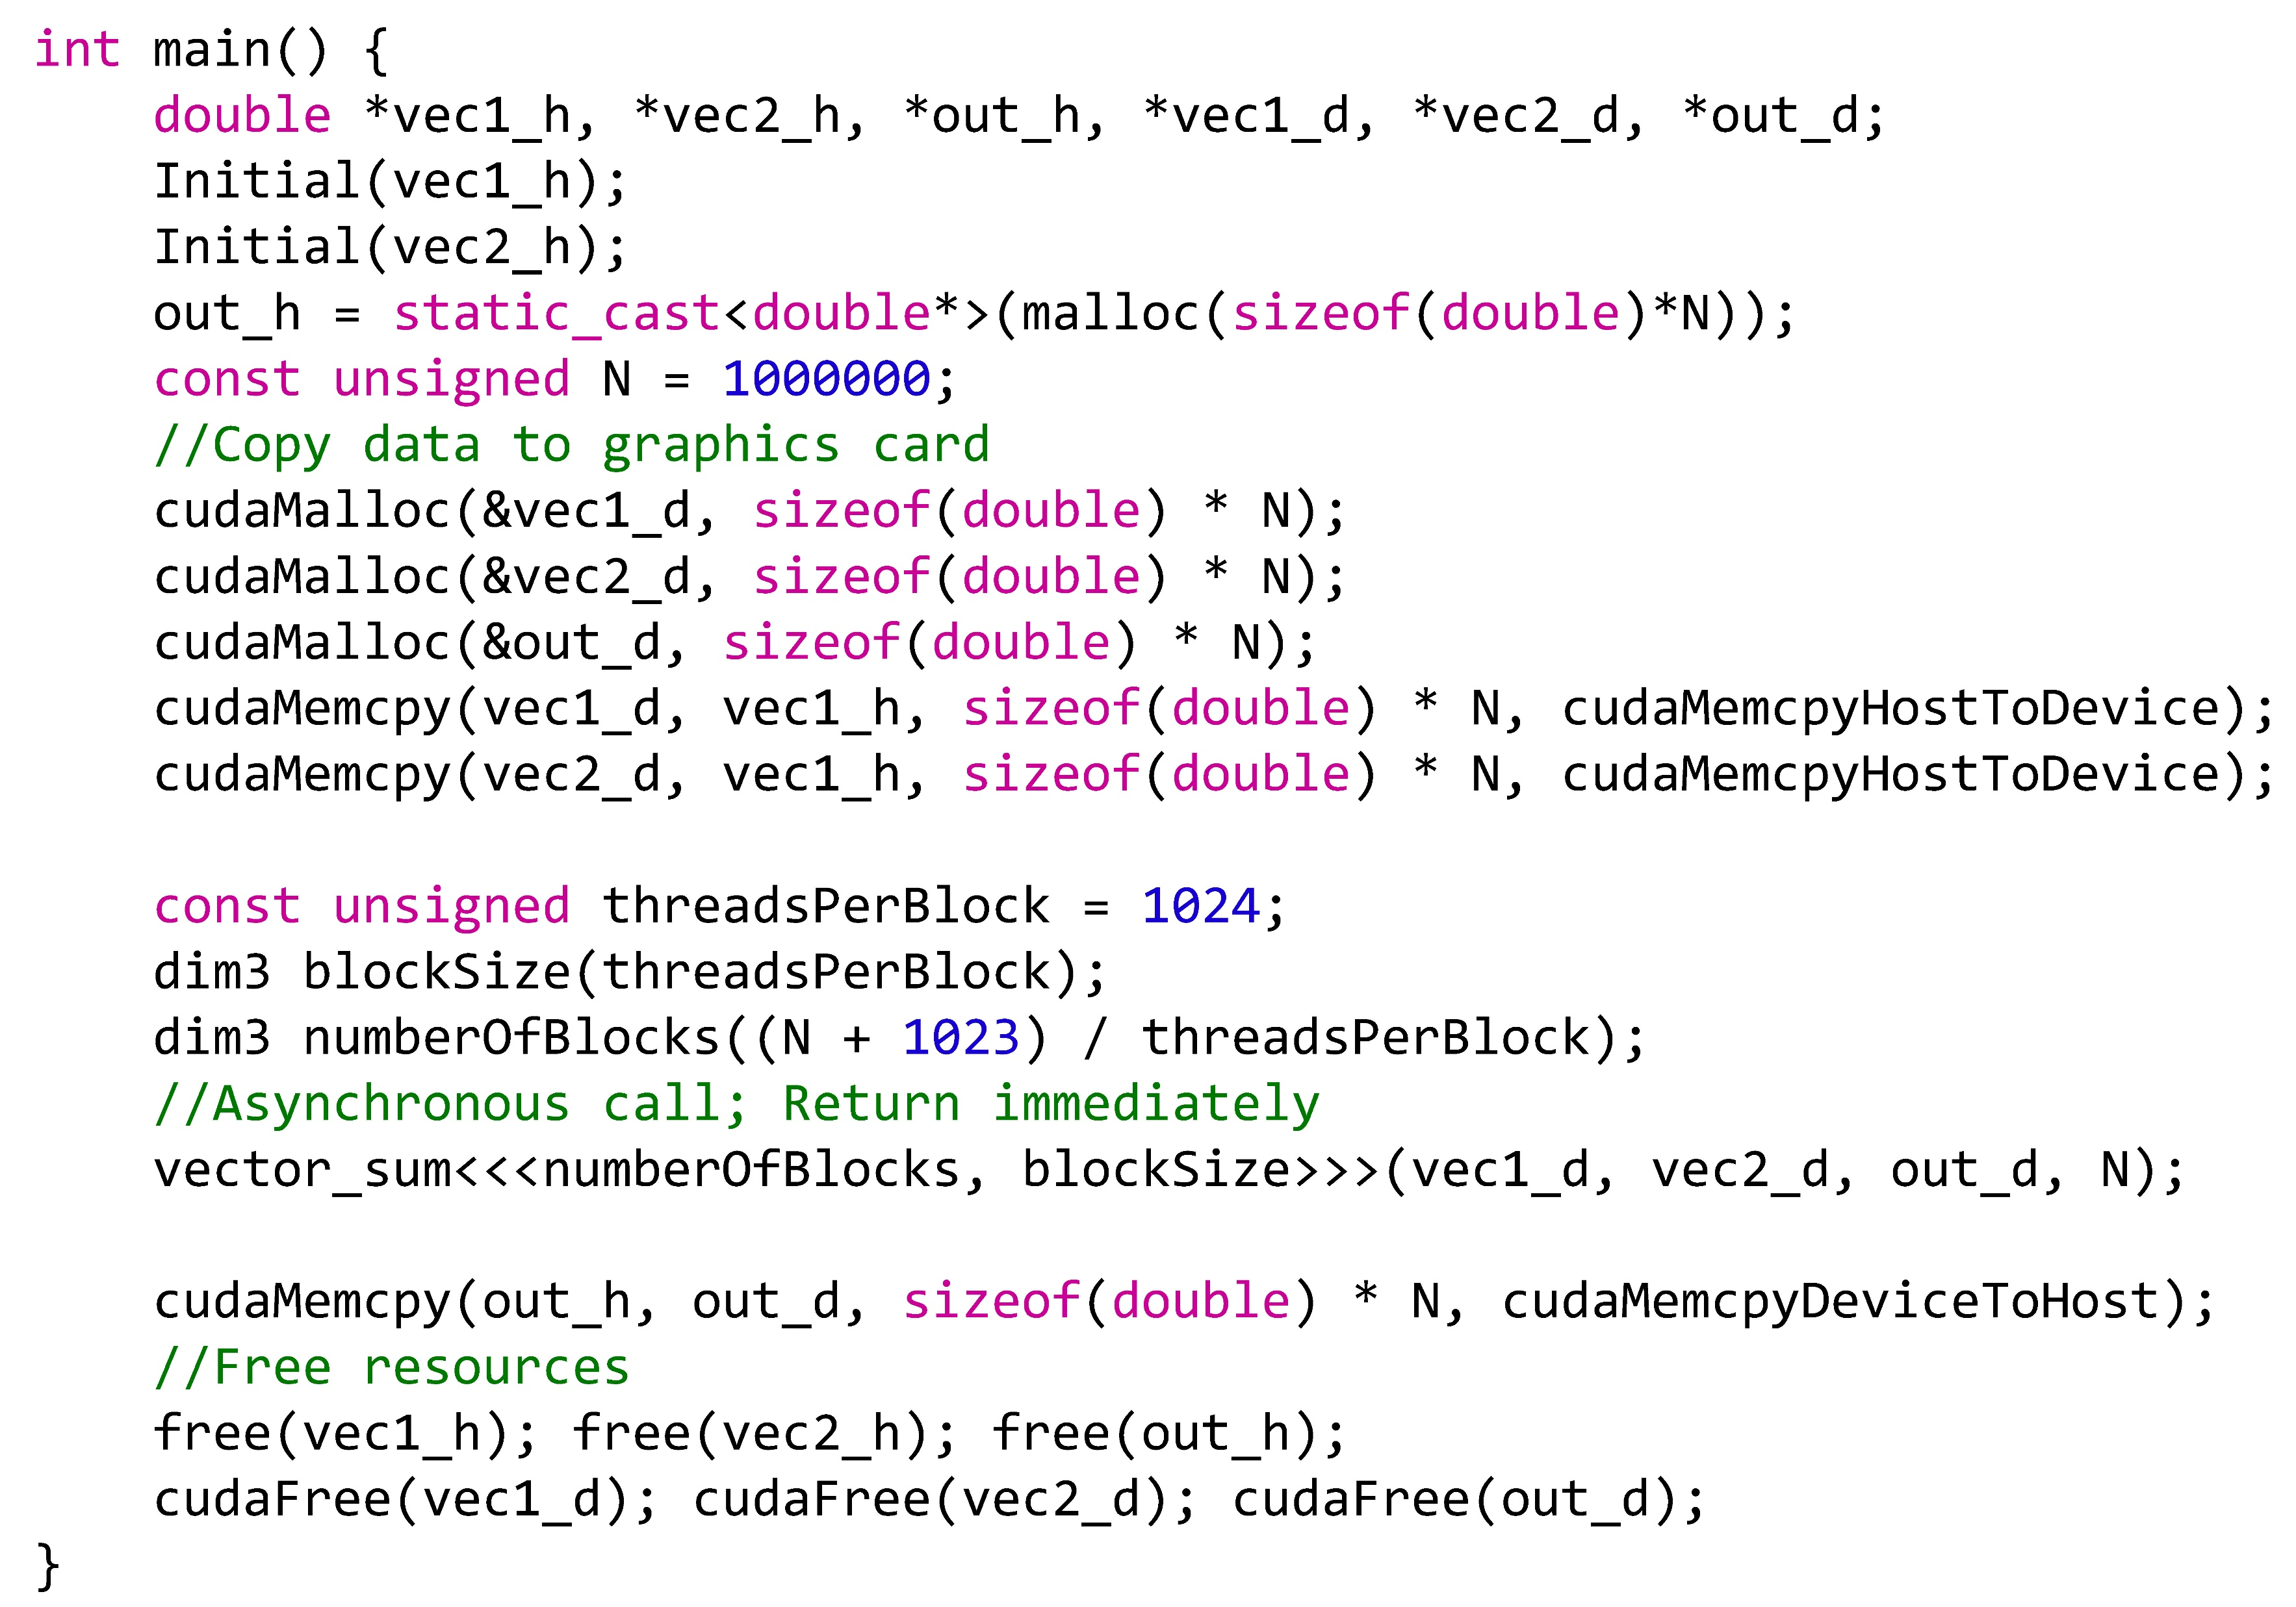
Kernel Launch

Slide 10
CUDA Programming Steps
Allocate host memory
Initialize host memory
Allocate device memory
Copy host memory to device
Setup execution parameters
Execute the kernel
Copy result from device to host
Clean up memory

Slide 11
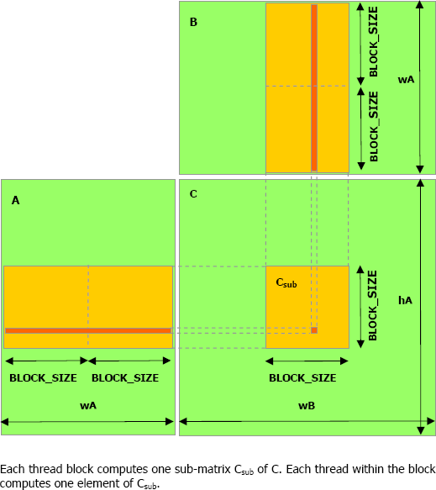
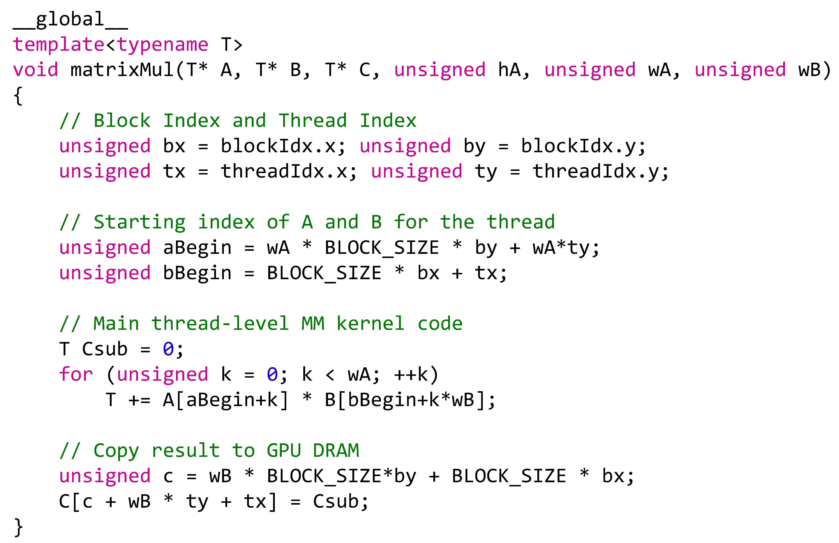
Matrix Multiplication

Slide 12
Reduction
Summation of all elements in an array

Slide 13
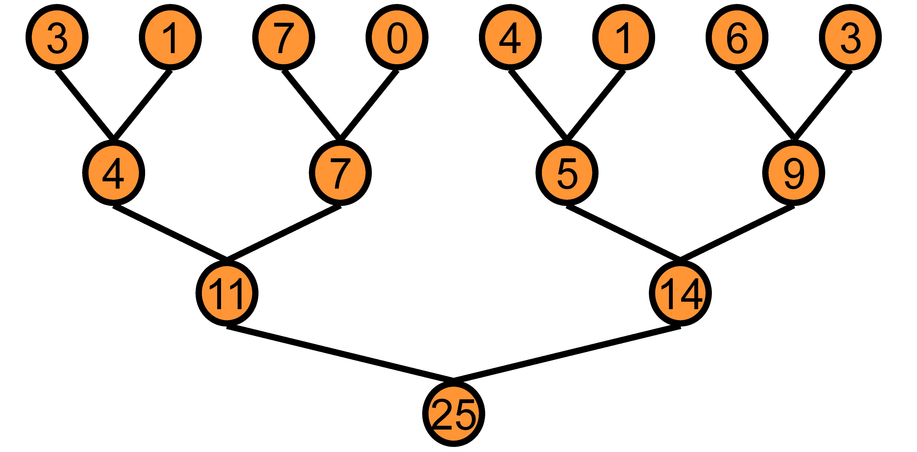
Reduction

Slide 14
Device
Stream Processor N
Stream Processor 1
Stream Processor 0 (SM)
Instruction Cache
Shared Memory
Warp 0
Warp 1
Warp N
Shared Registers File
Shared Registers File
Shared Registers File
Core 0
Core 30
Core 32
Core 62
Core …
Core …
Core 1
· · ·
Core 31
Core 33
· · ·
· · ·
Core …
· · ·
Core …
Core 63
Warp Scheduler
Warp Scheduler
Warp Scheduler
Instruction Buffer
Instruction Buffer
Instruction Buffer
Constant Memory
Texture Memory/L1 Cache
L2 Cache
Global Memory

Slide 15
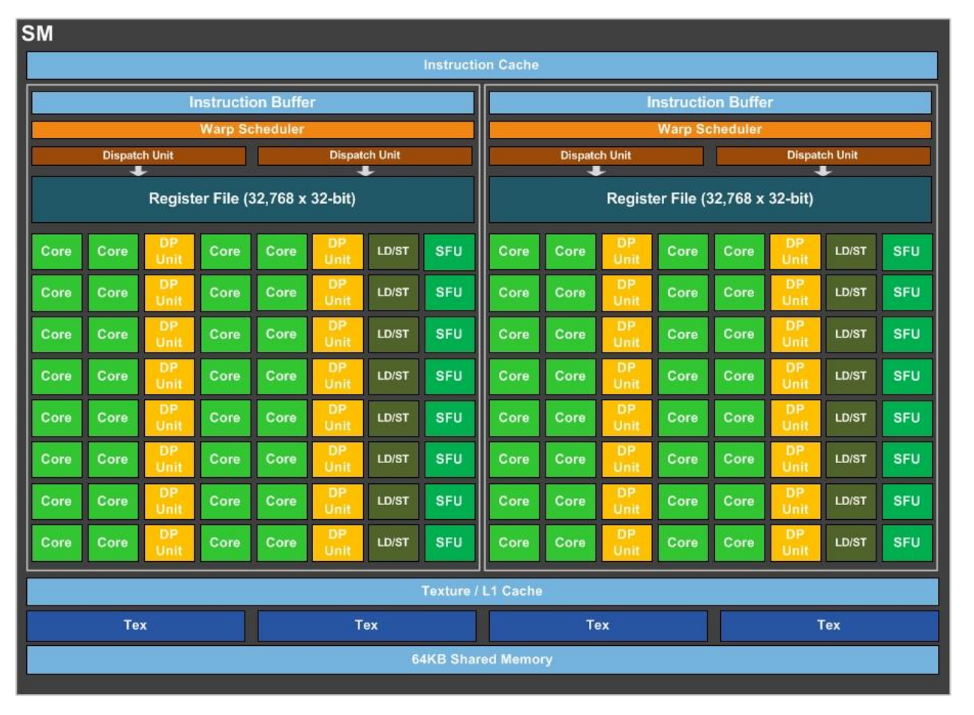
Reduction with Intrinsic

Slide 16
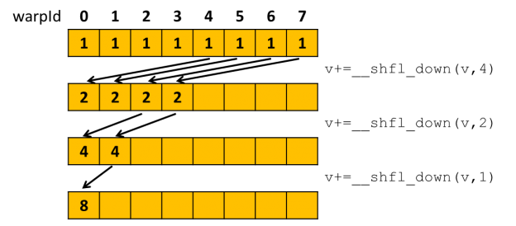
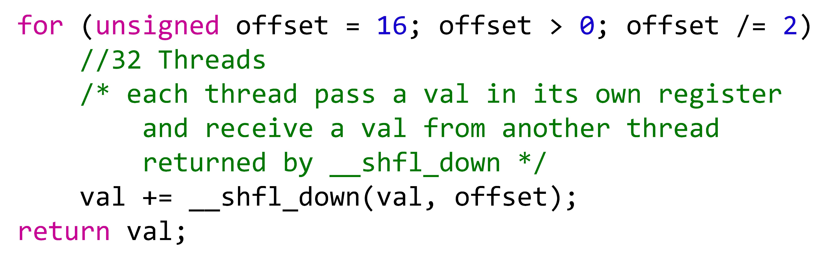
Reduction with Intrinsic

Slide 17
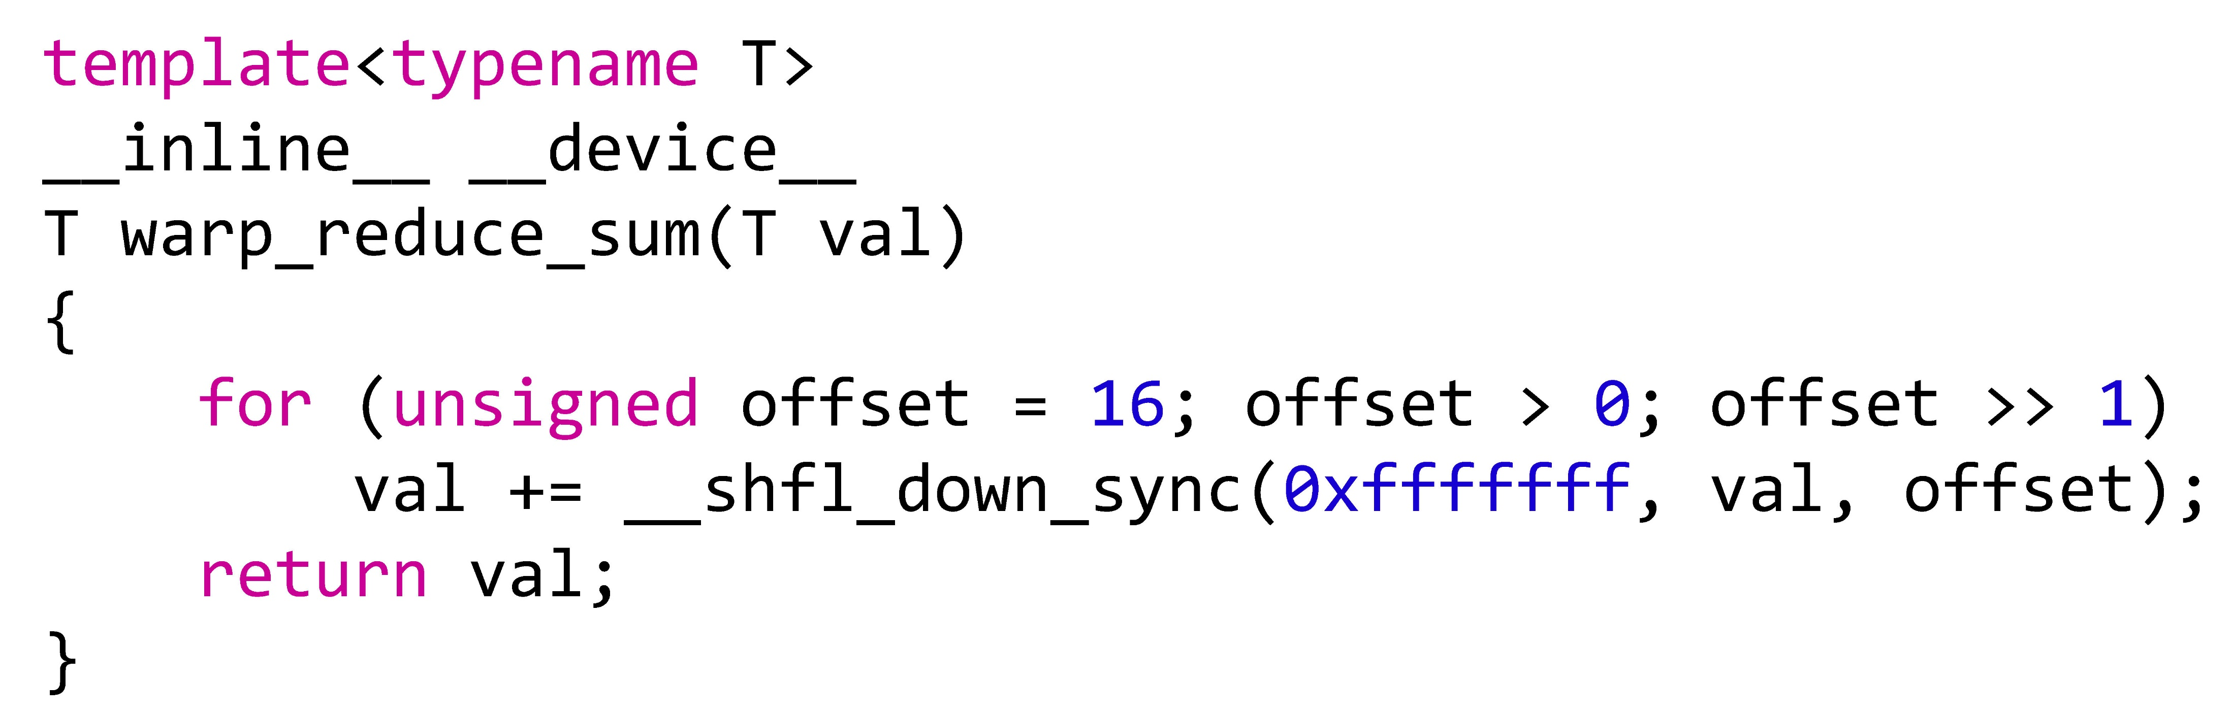
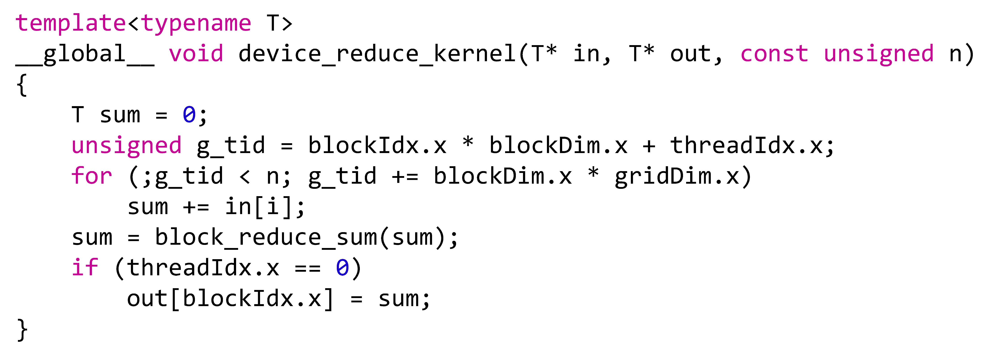
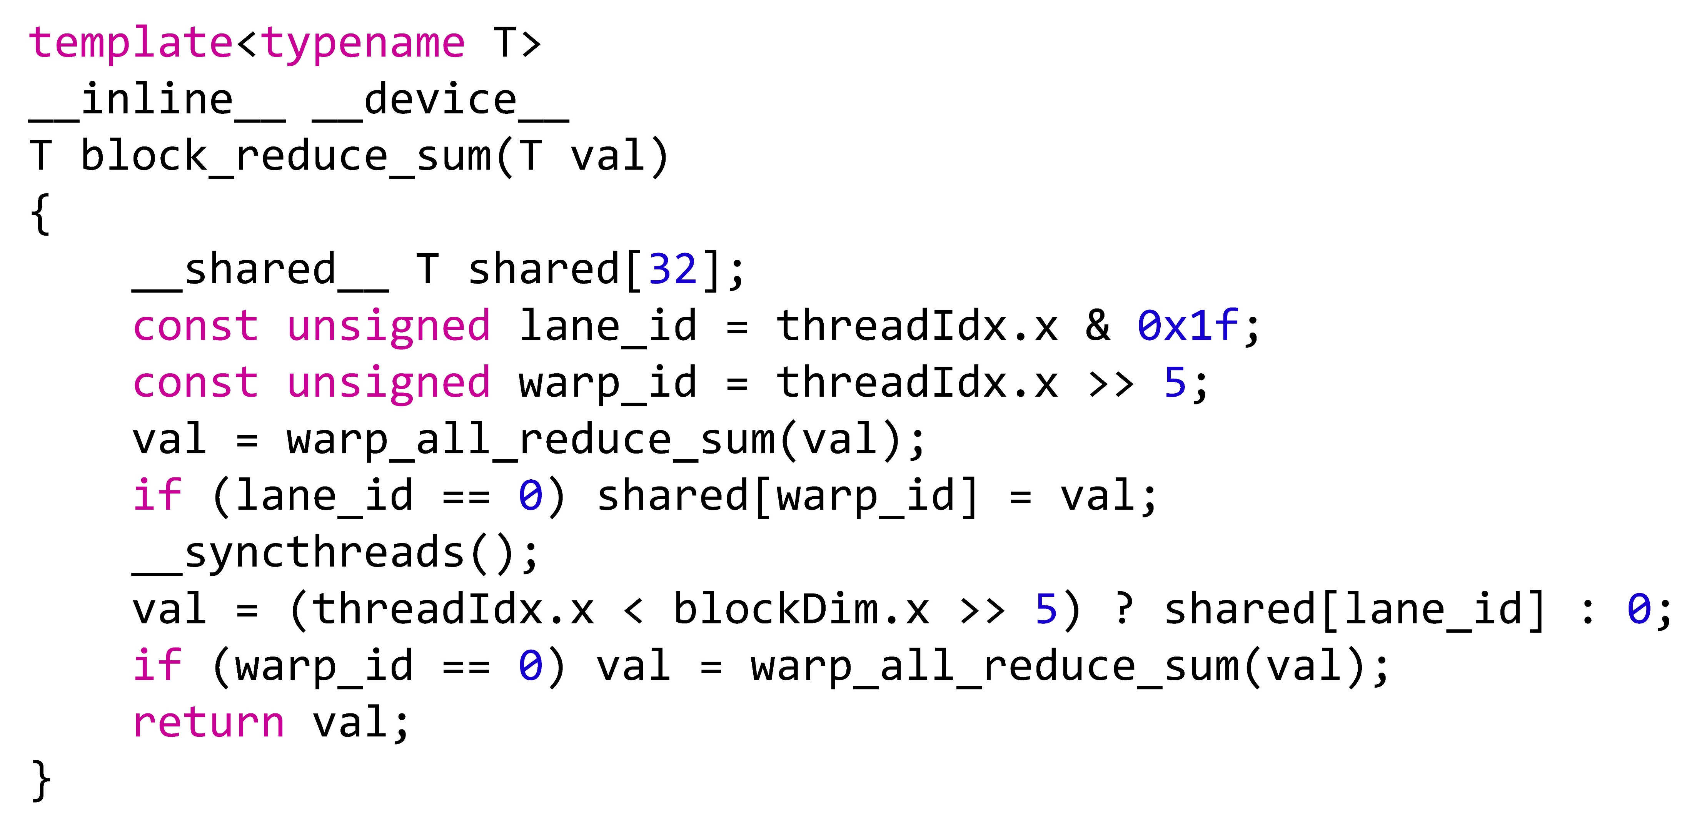

Slide 18
Other Fun Intrinsics
https://docs.nvidia.com/cuda/cuda-c-programming-guide/index.html#warp-vote-functions

